Slide 1
CAPSTONE PROJECT
Loan Analysis:
Finding Defaulters
Mentor: Nikita Tandel
Batch No: PGA - 9

Slide 2







Team
rachit.agarwal.2018@gmail.com
shreyashu07@gmail.com
vishweshdeore2202@gmail.com
https://www.linkedin.com/in/rac05
https://www.linkedin.com/in/shreyash24
https://www.linkedin.com/in/vishweshdeore22
https://github.com/VishweshDeore
https://github.com/shreyash2495
https://github.com/Rachit005

Slide 3
Data Analytics Process
Business Understanding
Data Preparation
Model Evaluation
Data Exploration
Building Models

Slide 4
Loan Analysis Overview
Identifying the Business Problem
Data Description
Visualisations: Data Understanding
Exploratory Data Analysis (EDA Tools)
Predictive Modelling & Evaluation
Basic User Interface for the Client
Conclusion
Recommendations

Slide 5
Identifying the Business problem
Banks may face huge losses due to the defaults made by their clients which increases the rejection rate of the loan applicants. To overcome this situation, we need a better credit risk scoring model which can correctly identify which applicant will be a defaulter in the future. This will be done by analysing the historic data and identifying the patterns. Such a model would minimize credit risk and will prevent the clients which are capable of repayment from getting rejected.
Borrower
Loan issuer
Investors

Slide 6
Data Description
The dataset contains complete loan data for all loans issued through the year 2007 - 2015, including the current loan status (Current, Late, Fully Paid, etc.) and latest payment information.
Our dataset contains total of 8,55,969 records with 73 features including target variable.
Moreover, the dataset is very unbalanced, with approximately 6 % of loans considered as defaulted.
This dataset has different types of features such as categorical, numeric & date.

Slide 7

Some important features of a loan
loan_amnt - Amount of money requested by the borrower.
int_rate - Interest rate on the loan.
grade - Loan grade with categories A, B, C, D, E, F, G.
annual_inc - Borrowers annual income.
purpose - The primary purpose of borrowing.
installments – Monthly amount payments for opted loan.
term – duration of the loan until it’s paid off
dti – ratio of your gross monthly income that goes to paying your monthly debt payments.

Slide 8
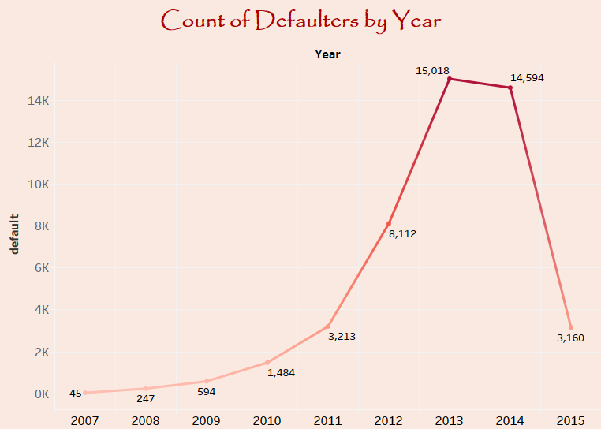
Visualisations: Data Understanding
The number of defaulters show a significant rise during the years from 2012 to 2014, some of the generalized reasons affecting this might be
LIBOR Scandal
Hurricane Sandy
Hostess Files for Bankruptcy

Slide 9
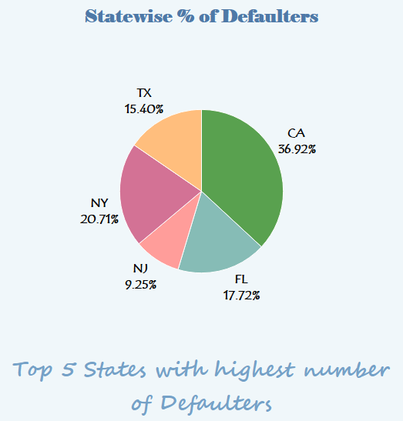
.
State | Defaulters(Percent)
California | 36.92
New York | 20.71
Florida | 17.72
Texas | 15.4
New Jersey | 9.25

Slide 10
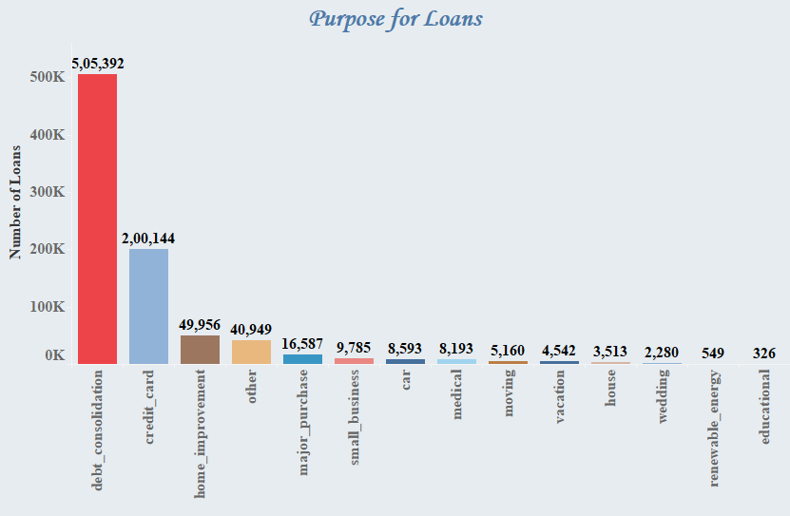
Loan Purpose is the primary reason a borrower requesting a loan.
Major Reason for purpose of loan are debt consolidation followed by credit card.

Slide 11
Exploratory Data Analysis
Prior to data mining model analysis, the data was reviewed, cleaned and prepared as follows:
Renaming the variables – We renamed the variables as per our convenience and domain knowledge.
Extracting the values –
Extracted the values of variables like emp_length, term.
emp_length had values in string where we have extracted the numeric part.
E.g.: - '10+ years' -> 10
'2 years' -> 2
'1 year' -> 1
'<1 year' -> 0
Did the same for the term where values were in string.
E.g.: - 36 months -> 36
60 months -> 60

Slide 12
Replacing the values from one variable to another variable
Replacing the income value of borrower with co-borrower on basis of application type.
If application_type is INDIVIDUAL then income of borrower will remain as it is and if application_type is JOINT then the existing value of income of borrower is replaced with income of joint. whereas income of joint is the combined income value of borrower and co-borrower. The same procedure is for dti/ratio_inc_exp_borrower and dti_joint/ratio_inc_exp_joint.
Replacing the values in Home Ownership variable
Replacing 'OTHER', 'ANY' & ''NONE' values with ''OTHER’

Slide 13
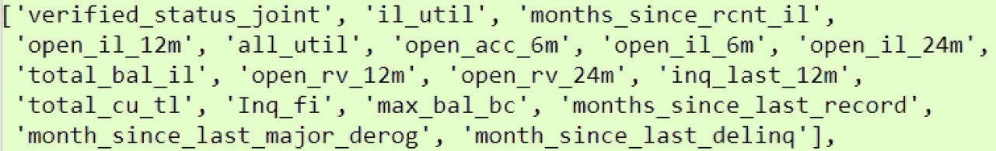
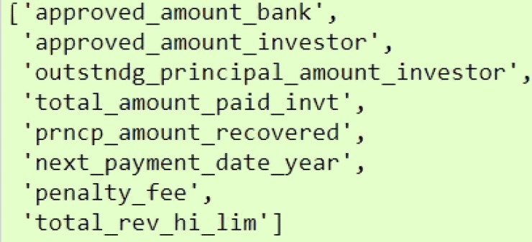
Dropping Variables –
Dropped the variables which were not needed for building models
member_id -> every value is unique
emp_title, desc, zip_code, title, sub_grade
policy_code -> every value is 1
Dropped those variables which contain more than 50% of null values
Dropped those variables which having multicollinearity greater than 0.7

Slide 14
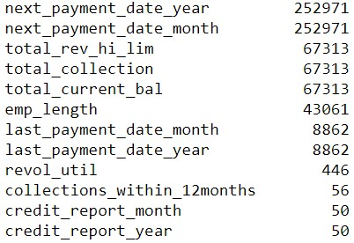
Imputation of Missing Values
Imputed the above missing data with zero values.

Slide 15
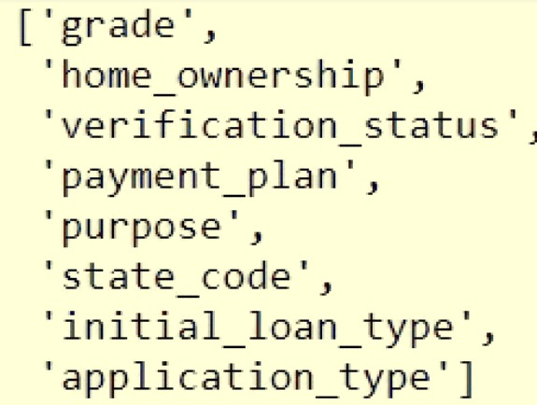
Label Encoder
Label Encoder is a technique used to convert the categorical variables to numeric variables.
The above variables are categorical and we have applied Label encoder technique. In this technique, we have two function fit and transform.
Steps of Label Encoder:
Fetching the unique values
Arranging them in ascending order
Mapping the values starting with 0,1,2 and so on.
Fit function will perform all the above three steps.
Transform function will actually replace the data values in the dataframe.

Slide 16
Train Test Split
Splitting the data into train and test on issue_date variable.
The Training part contains data from June 2007 to May 2015.
Testing part is from June 2015 to December 2015.
Train Size – 598978 records with 38 features
Test Size – 256991 records with 38 features
Scaling the data
Feature Scaling is a technique to standardize/normalize the independent features present in the data in an approximate range.
Scaling is used to ensure uniformity across the data.
There are two methods of Scaling:
Standardization: In standardization, approximate range is -3 to +3
Normalization: In normalization, fixed range is 0 to 1
In this dataset, we have used standardization technique to scale the data.

Slide 17
Predictive Modelling and Evaluation
Since the target/response variable output is in Binary form i.e. 0(Non-defaulters) and 1(defaulters) so this is a classification problem and we have used the below mentioned techniques:
01
02
03
04
05
06
ANN
(ARTIFICiAL NEURAL NETWORK)
Logistic Regression
Decision Tree
Bagging
ADABOOST
VOTING CLASSIFIER

Slide 18
Metrics used for Evaluation of Models
Confusion Matrix
RECALL SCORE
Precision SCore
F1- Score
Auc – ROC CURVE
ACCURACY SCORE

Slide 19
Logistic Regression
Adjusting threshold value – 70%
Default threshold value – 50%
Total Error - 151.
Total Error - 104
Type I error
TYPE II ERROR
TYPE II ERROR
88
Type I error
65
63
39

Slide 20
Decision Tree
Default Hyperparameters
criterion – ‘gini’
max_depth – None
min_samples_leaf – 1
Tuned Hyperparameters
criterion – ‘gini’
max_depth – 11
min_samples_leaf – 5
Precision Score
F1 - Score
96%
96%
Precision Score
F1 - Score
11%
6%

Slide 21
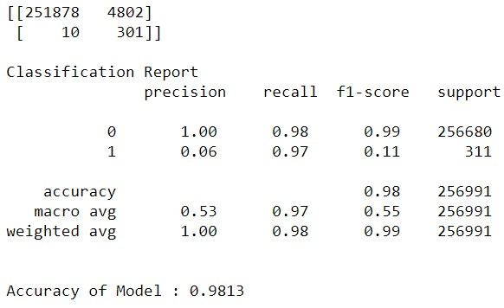
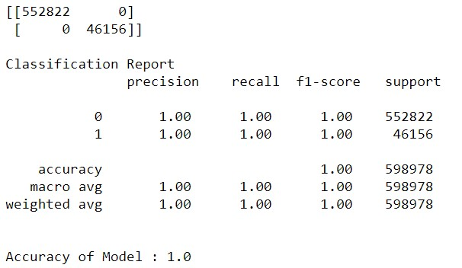
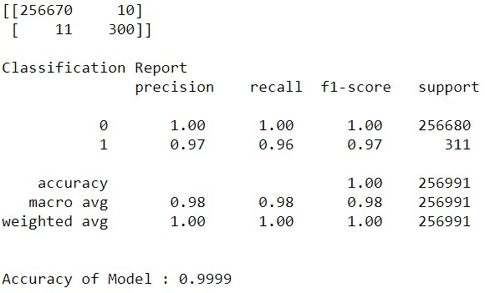
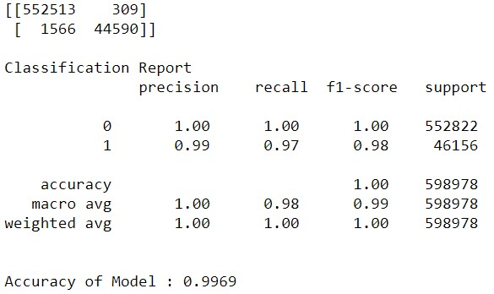
Prediction on Testing Data
Prediction on Training Data
Decision Tree
Tuned Decision Tree

Slide 22
Bagging and AdaBoost
Hyperparameters
n_estimators = 50
The number of trees in the forest
base_estimator: The base estimator from which the boosted ensemble is built.
n_estimator = 10: Maximum number of estimators at which boosting is terminated. In case of perfect fit, the learning procedure is stopped early.
Total Error - 11.
Total Error - 10
TYPE II ERROR
Type I error
Type I error
TYPE II ERROR
11
10
0
0

Slide 23
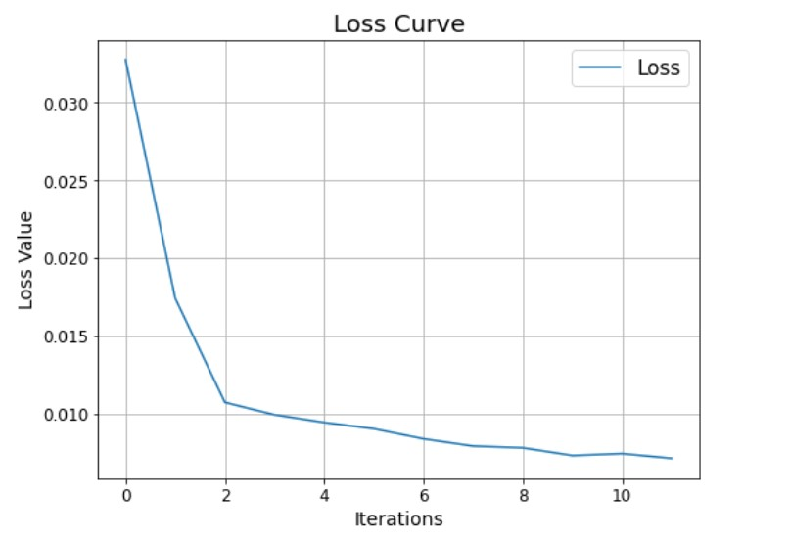
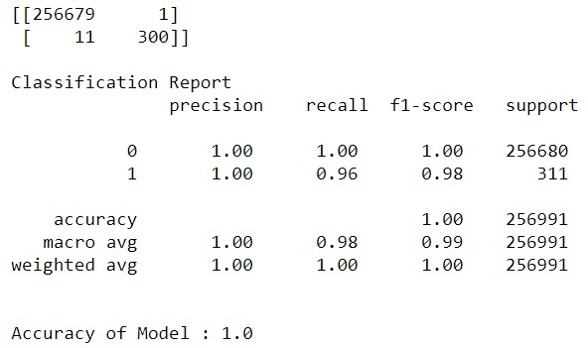
ANN(Artificial Neural Network)
Class 1(Defaulters)
Precision Score – 100%
Recall Score – 96%
F1- Score – 98%
From the above graph, we can clearly see that from the 0th to 2nd iteration there is a steep decrease in the loss value.
.

Slide 24
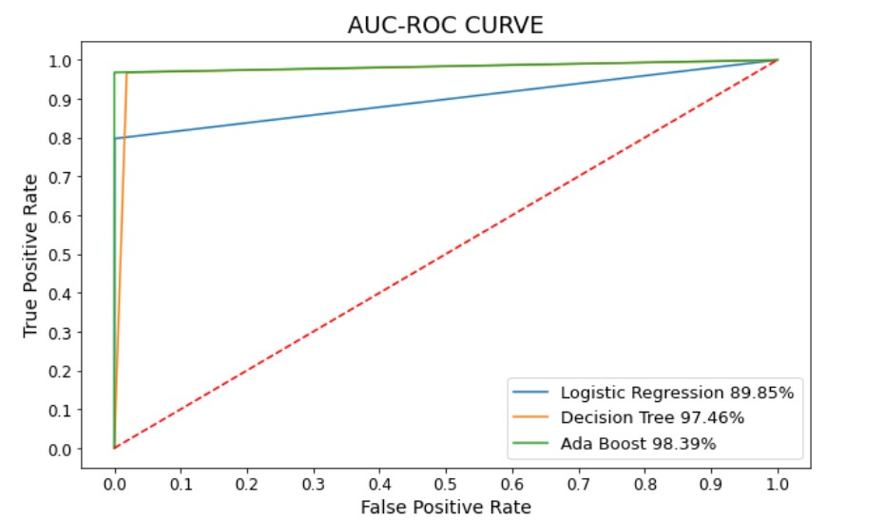
Model Comparison
Area Under Curve – Receiver Operating Characteristic

Slide 25
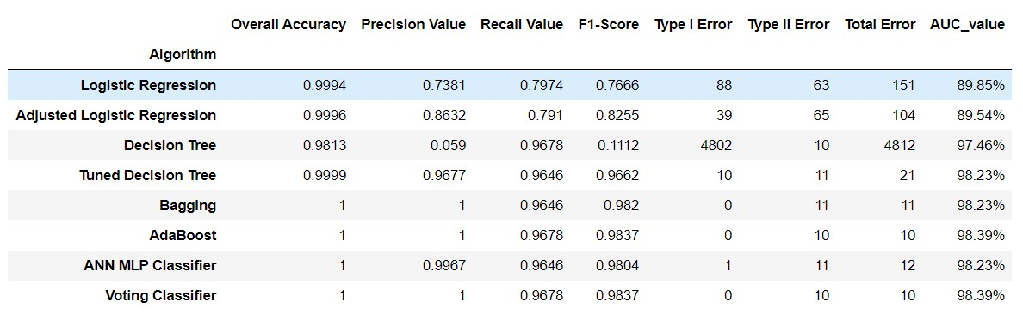
AdaBoost and Voting Classifier are the optimal models

Slide 26
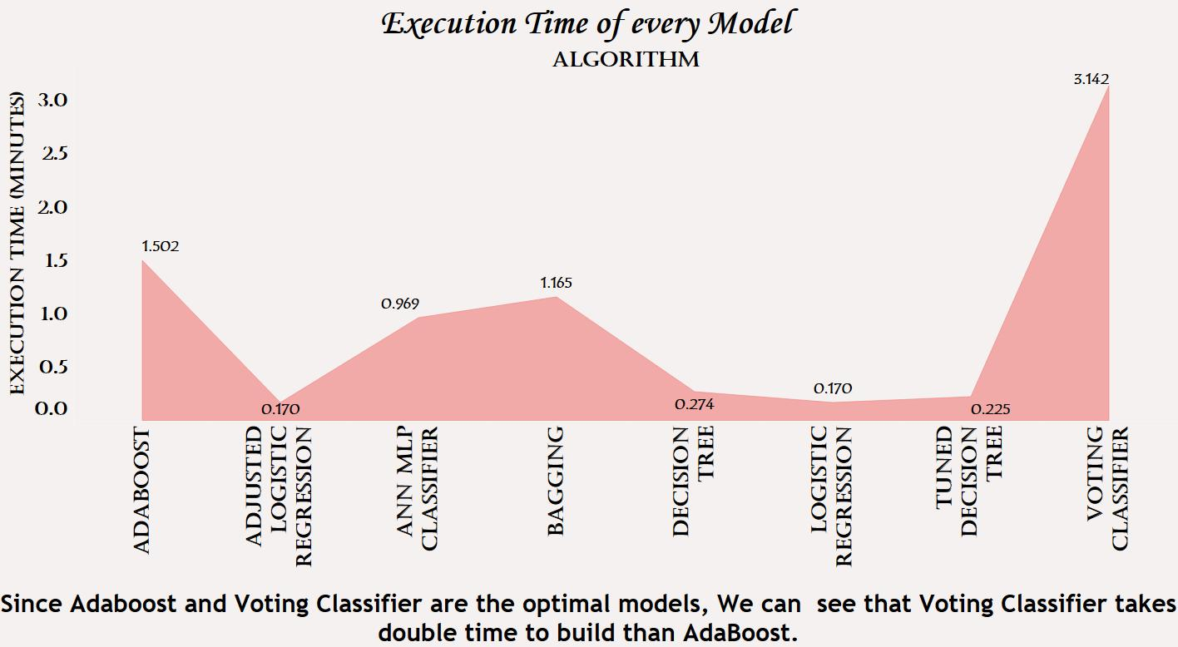
Conclusion
After using various machine learning algorithms, we have arrived on the conclusion that AdaBoost and Voting Classifier have performed well on the given dataset compared to rest of the algorithms.
Now taking execution time into account, we have chosen AdaBoost over Voting Classifier, as there is a high execution time involved in computing the Voting Classifier Model.

Slide 27
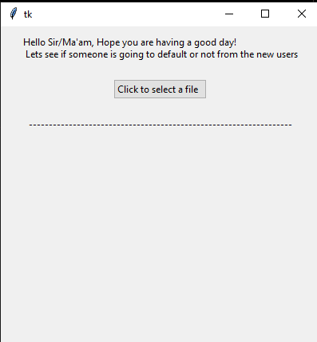
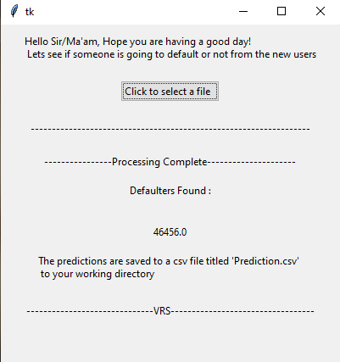
Basic User Interface
Designed a User Interface using TKinter for the client to implement the model for future predictions.

Slide 28
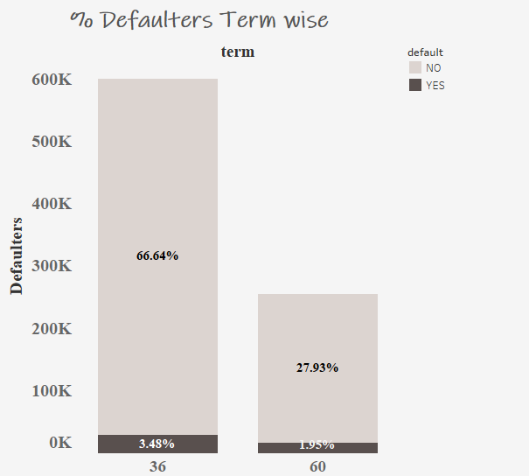
Recommendations
High Quality Borrowers
A borrower that chooses a short term (36 months) for the life of a loan implies that they are committed to paying off the debt as quickly as possible.
However, we have found that the shorter loan term (36 months) had more defaults than the lengthier term (60 months).
If a borrowers apply for a loan, suggest him/her for the 60 months term loan rather than 36 months.

Slide 29
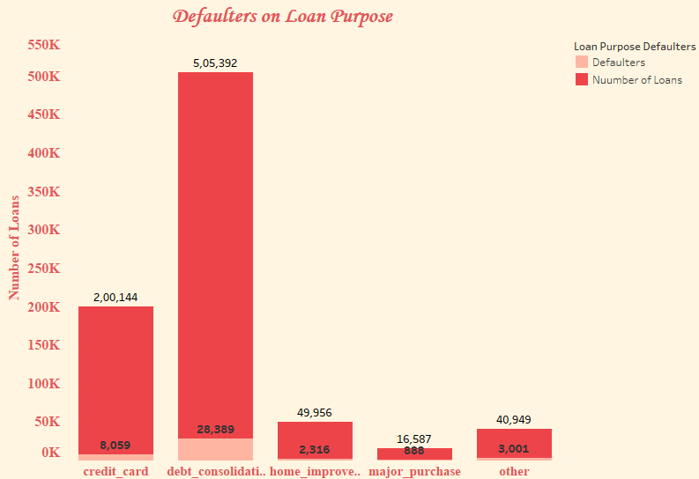
High Quality Borrowers
The most common type of unsecured loans are debt consolidation, credit card, student loans, personal loans and more.
Reduce the number of approvals where purpose is debt_consolidation followed by credit_card.

Slide 30
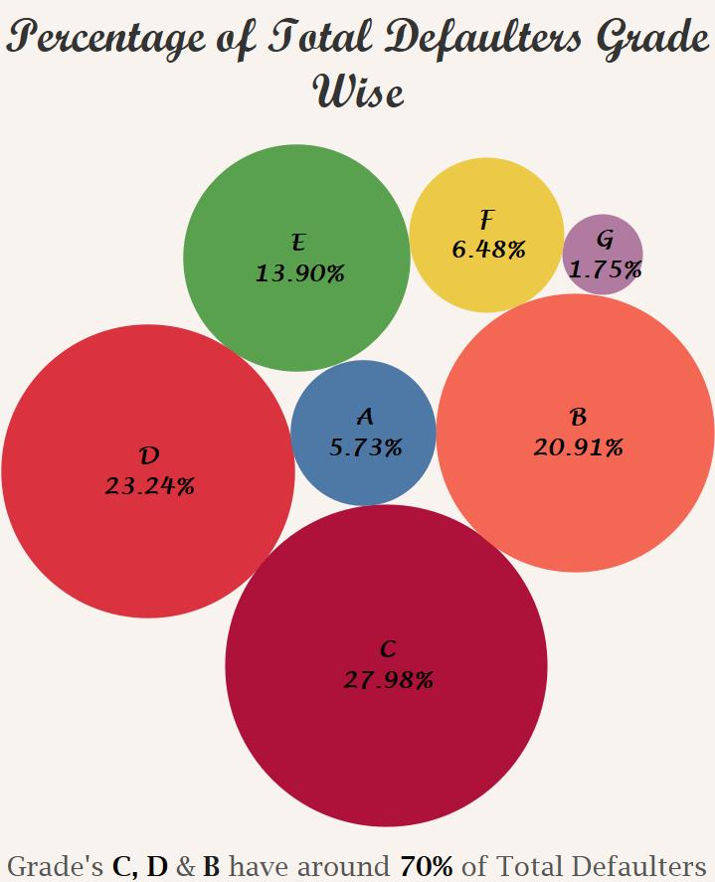
High Quality Borrowers
Now we can see that majority of the loan defaulters lies in grades C, D and B. So, we suggest to reduce the loan approvals for these grades.

Slide 31
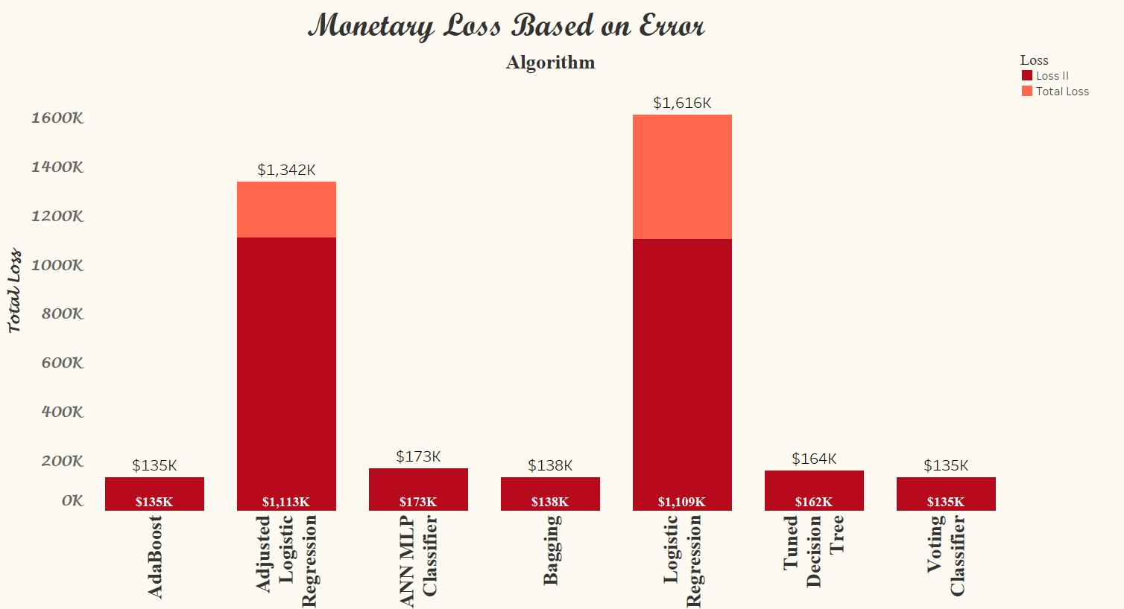
Loss II – Actual value is defaulters and Predicted them as Non- defaulters.
By taking Loss II and AdaBoost Model into consideration, we can say that the loan issuer facing a loss of $135K.

Slide 32
IDEA
CHALLENGES
SUCCESS
TEAM
VALUES
DEDICATION
INSIGHTS

